Slide 1

Object Oriented Design and Programming (01AI0403)
Unit – 6
Inheritance

Slide 2

OUTLINE
Concept of inheritance
Derived class and based class
Derived class constructors,
Member function,
Class hierarchies,
Public and Private inheritance.

Slide 3
Concept of inheritance
Inheritance is a fundamental concept in object-oriented programming (OOP) that allows you to create new classes based on existing classes.
It is a mechanism by which one class acquires the properties and methods of another class, called the parent or base class.
The class that inherits the properties and methods is known as the derived class or subclass.
The derived class can extend or modify the behaviour of the base class by adding new methods or overriding existing ones.

Slide 4
Benefits of Inheritance
Code reuse: Inheritance enables you to create new classes that reuse the properties and methods of existing classes, thus reducing the amount of code you need to write.
Easy maintenance: When you modify the base class, the changes are automatically reflected in all the derived classes. This makes it easy to maintain code and avoid duplicating code changes in multiple places.
Polymorphism: Inheritance facilitates polymorphism, which allows you to treat objects of different classes as if they were instances of a common base class. This makes it easy to write generic code that can work with multiple types of objects.

Slide 5
Benefits of Inheritance
Flexibility: By allowing you to create new classes based on existing ones, inheritance makes it easy to extend and modify code to meet changing requirements.
Modularity: Inheritance promotes modularity by allowing you to define separate classes for specific functionalities and then combine them using inheritance.
Reduced complexity: Inheritance promotes hierarchical classification, which reduces the complexity of code by organizing it into a logical and understandable hierarchy.
Encapsulation: Inheritance supports encapsulation, as the properties and methods of a base class can be hidden from the derived class, ensuring that the derived class only accesses what it needs to.

Slide 6
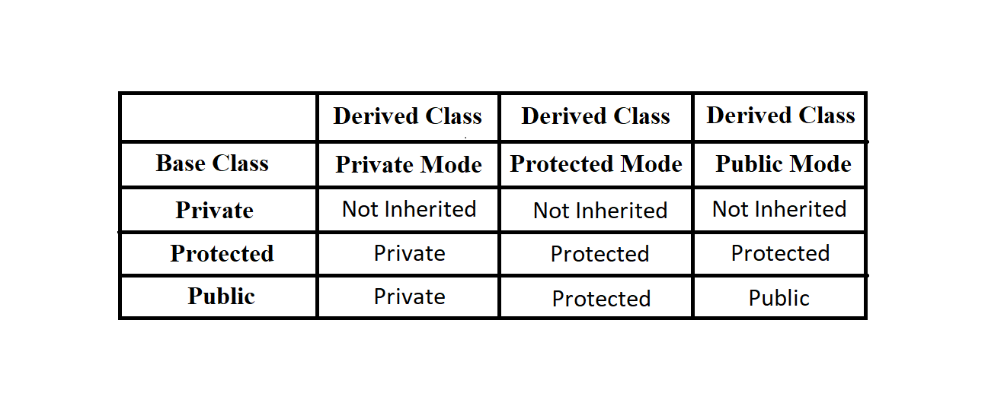








Access Mode in C++ Inheritance

Slide 7
Inheritance
The syntax for defining a derived class in most programming languages involves specifying the base class from which it inherits. The derived class can then access and use the members (variables and methods) of the base class,
Syntax:
class base_class_name
{
..................
};
class derived_class_name : access_specifier base_class_name
{
...........
} ;

Slide 8
Inheritance – Types
There are different types of inheritance, such as:
Single inheritance - A derived class inherits from a single base class.
Multiple inheritance - A derived class inherits from multiple base classes.
Multilevel inheritance - A derived class becomes the base class for another derived class.
Hierarchical inheritance - Multiple derived classes inherit from a single base class.
Hybrid inheritance - A combination of multiple inheritance and multilevel inheritance.

Slide 9
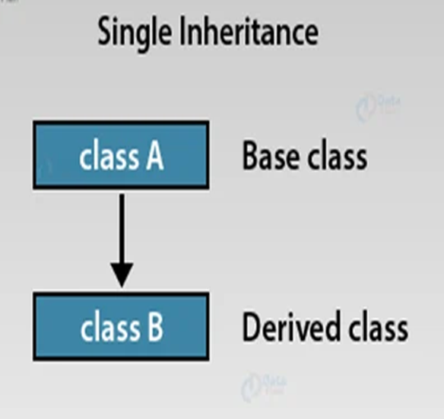
Single Inheritance
Single inheritance is only one derived class formed from a base class. In this inheritance, a single class inherits the properties of a base class.
All the data members of the base class are accessed by the derived class according to the visibility mode (i.e., private, protected, and public) that is specified during the inheritance.

Slide 10
Single Inheritance
Syntax:
class Base_class { // Body of the base class }; class Derived : access_specifier Base_class { // Body of the derived class };

Slide 11
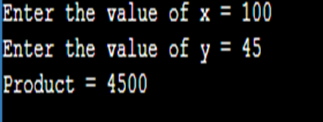
Single Inheritance - Example
#include <iostream>
using namespace std;
class base //single base class
{
public:
int x;
void getdata() {
cout << "Enter the value of x = ";
cin >> x;
}
};
class derive : public base //single derived class
{
private:
int y;
public:
void readdata() {
cout << "Enter the value of y = ";
cin >> y;
}
void product() {
cout << "Product = " << x * y;
}
};
int main() {
derive a; //object of derived class
a.getdata();
a.readdata();
a.product();
return 0;
}
Output:

Slide 12
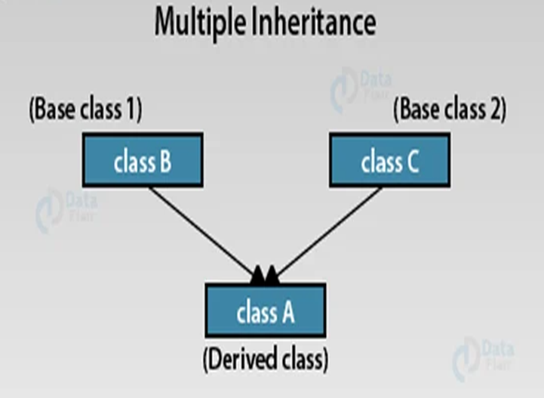
Multiple Inheritance
When the child class inherits its properties from more than one base class.
If a class is derived from two or more base classes then it is called multiple inheritance.

Slide 13
Multiple Inheritance
Syntax
class A // Base class A { // Body of the class A }; class B // Base Class B { // Body of the class B }; class C : acess_specifier A, access_specifier B // Derived from of A and B { // Body of class C };

Slide 14
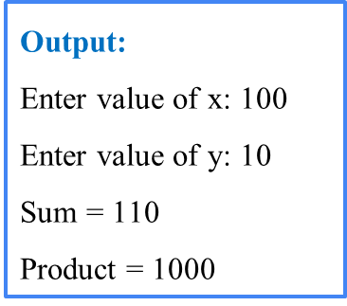
Multiple Inheritance - Example
#include<iostream>
using namespace std;
class A // base 1
{
public:
int x;
void getx()
{
cout << "Enter value of x: ";
cin >> x;
}
};
class B // base 2
{
public:
int y;
void gety()
{
cout << "Enter value of y: ";
cin >> y;
}
};
class C : public A, public B //C is derived from Class A and class B
{
public:
void sum()
{
cout << "Sum = " << x + y<<endl;
}
void product()
{
cout << "Product = " << x * y;
}
};
int main()
{
C obj1; //object of derived class C
obj1.getx();
obj1.gety();
obj1.sum();
obj1.product();
return 0;
}

Slide 15
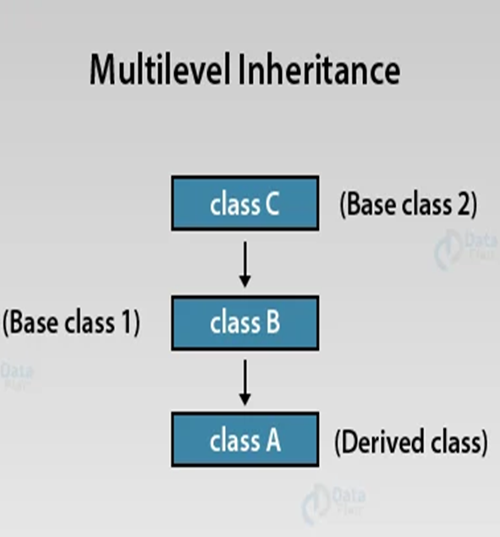
Multilevel Inheritance
This type of inheritance is the best way to represent the transitive nature of inheritance.
In multilevel inheritance, a derived class inherits all its properties from a class that itself inherits from another class.

Slide 16
Multilevel Inheritance
Syntax:
class A // Base class { // Body of class A }; class B : acess_specifier A // Derived class of A { // Body of class B }; class C : access_specifier B // Derived from derived class B { // Body of class C };

Slide 17
Multilevel Inheritance
#include<iostream>
using namespace std;
class Stud {
int rollNo;
char name[40];
public:
void get_info() {
cout<<"Enter the name of student:";
cin>>name;
cout<<"Enter roll number:";
cin>>rollNo;
}
void disp_info() {
cout<<"Name is:"<<name<<endl;
cout<<"Roll is:"<<rollNo<<endl;
}
};
class Exam: public Stud {
public:
int phymarks, chemmarks, mathsmarks;
void getmarks() {
cout<<"Enter physics marks:"<<endl;
cin>>phymarks;
cout<<"Enter chemistry marks:"<<endl;
cin>>chemmarks;
cout<<"Enter maths marks:"<<endl;
cin>>mathsmarks;
}

Slide 18
Multilevel Inheritance
void displaymarks() {
cout<<"Physics marks is:"<<phymarks;
cout<<“\nChemistry marks is:"<<chemmarks;
cout<<“\n Maths marks is:"<<mathsmarks;
}
};
class Result : public Exam{
public :
int total;
void showResult(){
total = phymarks + chemmarks + mathsmarks;
cout<<"Your total is:"<<total<<endl;
}
};
int main()
{
Result obj;
obj.get_info();
obj.getmarks();
obj.disp_info();
obj.displaymarks();
obj.showResult();
return 0;
}
Output:
Enter the name of student: Shreeja
Enter roll number: 2020201
Enter physics marks: 90
Enter chemistry marks: 89
Enter maths marks: 97
Name is: Shreeja
Roll is: 2020201
Physics marks is: 90
Chemistry marks is: 89
Maths marks is: 97
Your total is: 276

Slide 19
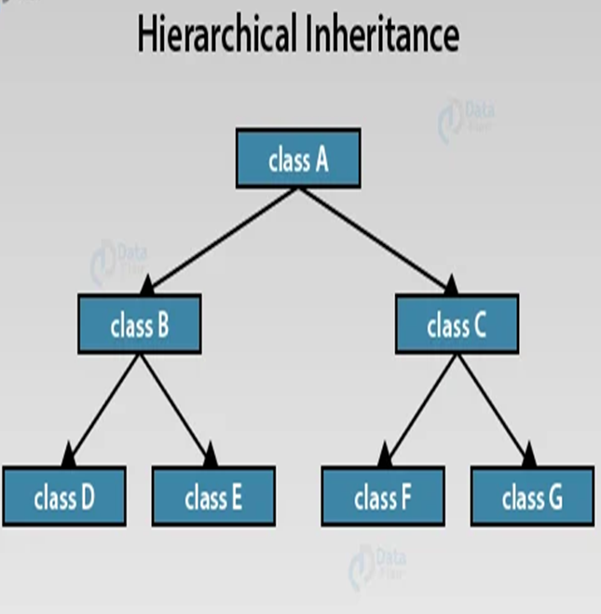
Hierarchical Inheritance
When multiple child classes inherit their properties from just a single base class.
The hierarchical inheritance structure forms a hierarchy or tree-like structure, where the parent class is at the top, and the child classes are below it.
Each child class inherits the properties and methods of the parent class, and it can also add its own unique properties and methods.

Slide 20
Hierarchical Inheritance
Syntax:
class A // Base class of B { // Body of the program }; class B : access_specifier A // Derived class of A { // Body of the program }; class C : access_specifier A // Derived class of A { // Body of the program }; class D : access_specifier A // Derived class of A { // Body of the program };

Slide 21
Hierarchical Inheritance
#include <iostream>
using namespace std;
class A //single base class
{
public:
int x, y;
void getdata()
{
cout << "\nEnter value of x and y:\n";
cin >> x >> y;
}
};
class B : public A //B is derived from class base
{
public:
void product()
{
cout << "\nProduct= " << x * y;
}
};
class C : public A //C is also derived from
// class base A
{
public:
void sum()
{
cout << "\nSum= " << x + y;
}
};

Slide 22
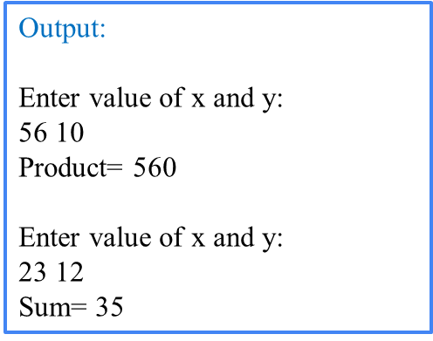
Hierarchical Inheritance
int main()
{
B obj1; //object of derived class B
C obj2; //object of derived class C
obj1.getdata();
obj1.product();
obj2.getdata();
obj2.sum();
return 0;
}

Slide 23
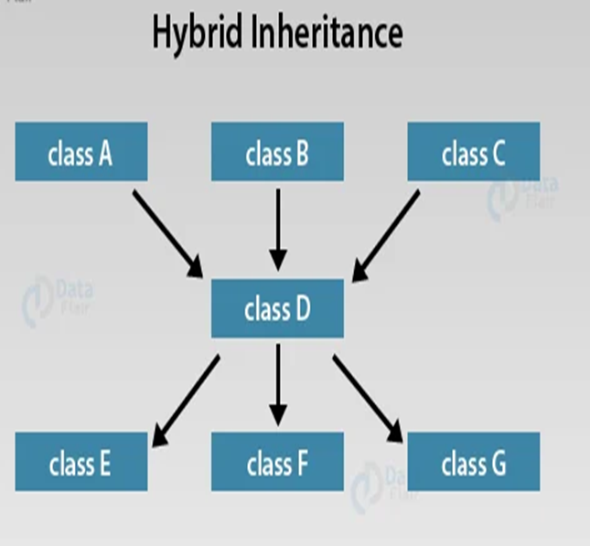
Hybrid Inheritance
This type of inheritance essentially combines more than two forms of inheritance.
When a child class inherits from multiple base classes all of its parent classes and that child class itself serves as a base class for 3 of its derived classes.

Slide 24
Hybrid Inheritance
Syntax:
class A { // Body of the class A }; class B : public A { // Body of the class B }; class C { // Body of the class C }; class D : public B, public C { // Body of the class D };

Slide 25
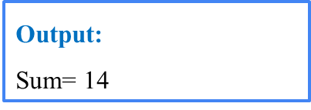
Hybrid Inheritance
#include <iostream>
using namespace std;
class A // base class 1
{
public:
int x;
};
class B : public A // derived 1
{
public:
B() //constructor to initialize x in base class A
{
x = 10;
}
};
class C // base 2
{
public:
int y;
C() //constructor to initialize y
{
y = 4;
}
};
class D : public B, public C //D is derived from class B and class C
{
public:
void sum()
{
cout << "Sum= " << x + y;
}
};
int main() {
D obj1; //object of derived class D
obj1.sum();
return 0;
}

Slide 26


